Slide 1

Fascinating World Of Meteorite Landings
ALY 6015 Introduction to Enterprise Analytics
Submitted by: Bhavesh Patidar and Tanishq Bakliwal
Submitted to: Prof. Zhi He
Date: 10/25/2023

Slide 2

INTRODUCTION
In our research project, we are delving into the fascinating world of meteorite landings, armed with a comprehensive dataset provided by The Meteoritical Society. This extensive dataset encompasses a wealth of information on 34,513 meteorites, allowing us to explore their various facts. From the meteorite type to its weight, and from whether it fell from the sky or was discovered, to the year of its landing, we have an array of key attributes at our disposal. The dataset also includes database information, and most notably, the latitude and longitude coordinates that pinpoint the exact locations of these celestial visitor’s landings.
The goal of this project is to verify and analyze meteorite distribution, type and classification. Along with this we will find the impact of meteorite over the time and what proportion of meteorites were observed falling versus those discovered later.

Slide 3
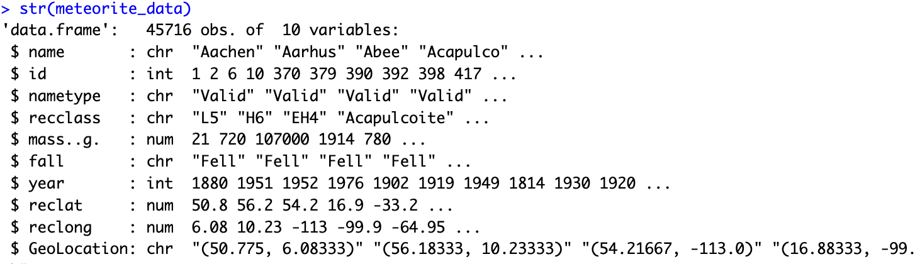
DATA SET
This dataset contains over 45000 rows and 10 columns with different observations.

Slide 4

METHEDOLOGIES
Linear Regression Model:
Linear regression is commonly used for predicting a continuous numeric target variable based on one or more input features. In the context of meteorite data, we could use linear regression to make predictions about a specific numeric attribute, such as predicting the mass of a meteorite based on other factors.
Multivariable Analysis:
Multivariable analysis is not a specific algorithm but a broad approach that involves studying relationships and patterns between multiple variables simultaneously. It's valuable for understanding how various factors interact and influence each other.

Slide 5
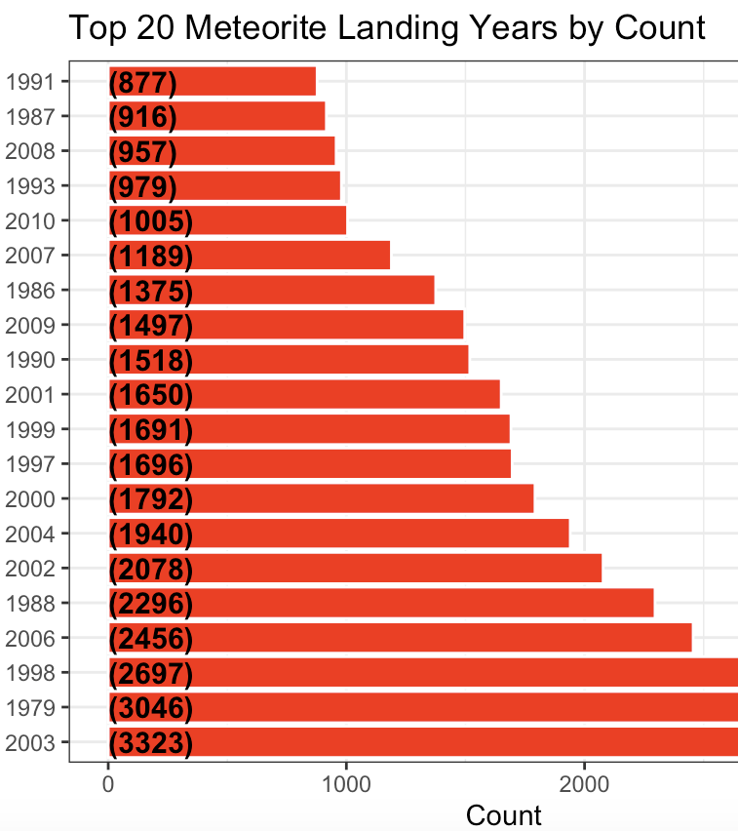
Top 20 meteorite landing years by count
The year with the most meteorite landings is 2003, with 3323 landings.
The year with the fewest meteorite landings is 1991, with 877 landings.
The average number of meteorite landings per year is 1743.
The median number of meteorite landings per year is 1715.
The mode number of meteorite landings per year is 1697.

Slide 6
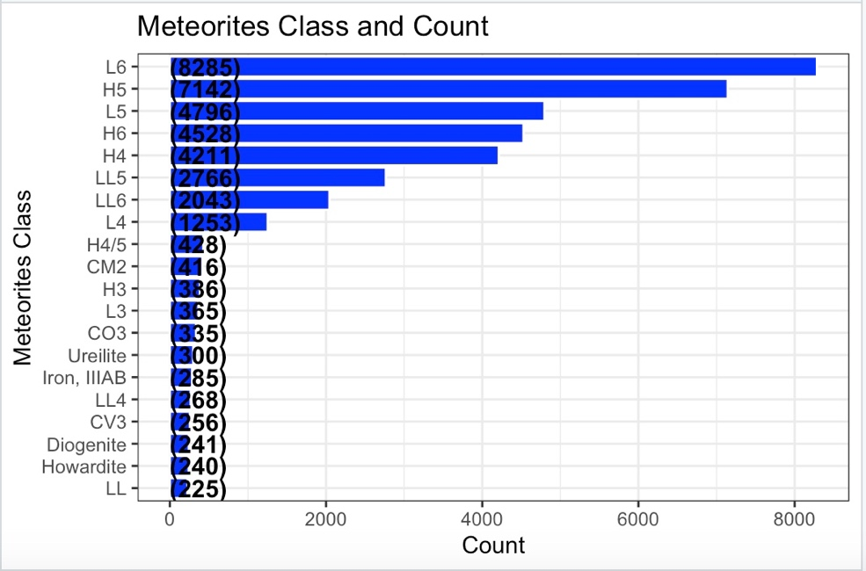
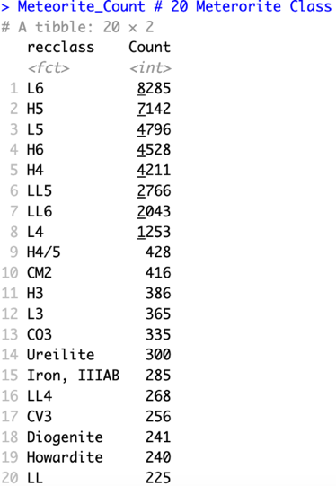
Meteorite count and class
L6 is the most frequent meteorite class, with 8,285 meteorites discovered. L5 (4,796 meteorites), H5 (7,142 meteorites), H6 (4,528 meteorites), and H4 (4,211 meteorites) follow. Ureilite is the least frequent meteorite class, with only 300 meteorites discovered.

Slide 7
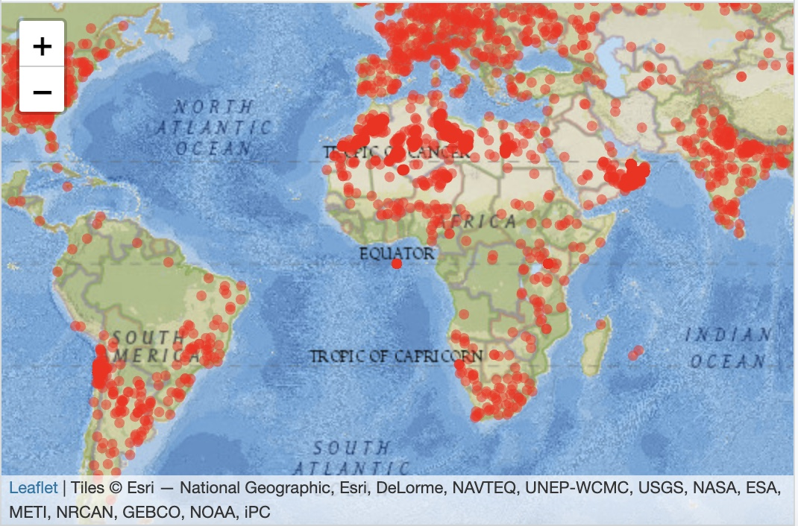
Landings of Meteorites
The Northern Hemisphere has more meteorite landings than the Southern Hemisphere.
Continental locations have more meteorite landings than marine areas.
Desert environments have more meteorite landings than non-desert places.
Landings of meteorites are more common in populous regions than in unpopulated places.

Slide 8
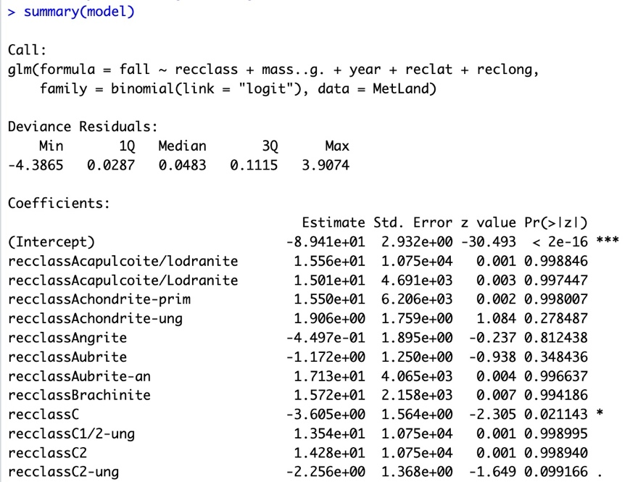
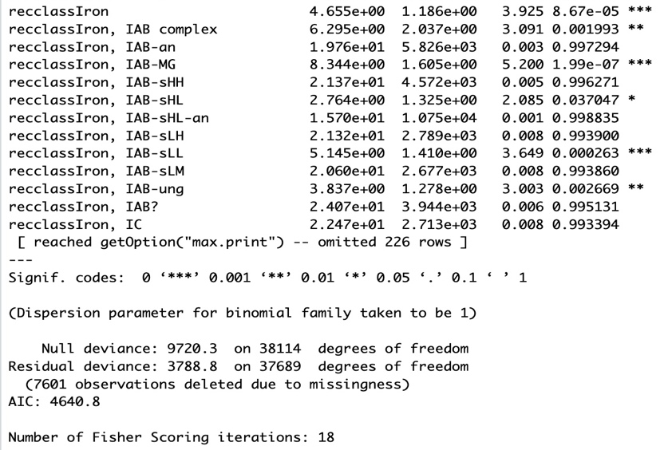
Logistic Regression
Estimated Coefficients: These are the estimated impacts of several parameters on the chance of a meteorite colliding with Earth.
P-Value: It is assigned to each component and represents the likelihood of achieving the estimated coefficient if the null hypothesis (no influence) is true.
Null Hypothesis: The null hypothesis asserts that a factor has no effect on the probability of a meteorite impact.
Level of Significance: If the null hypothesis is correct, a p-value of 0.05 or less is deemed statistically significant, suggesting a less than 5% possibility of receiving the estimated coefficient by chance.
Statistical Significance: If a factor's p-value is less than 0.05, it is considered a statistically significant predictor of meteorite strikes.
Inference: When all model parameters have p-values less than 0.05, it is possible to conclude that all of these factors are statistically significant predictors of meteorite strikes.

Slide 9
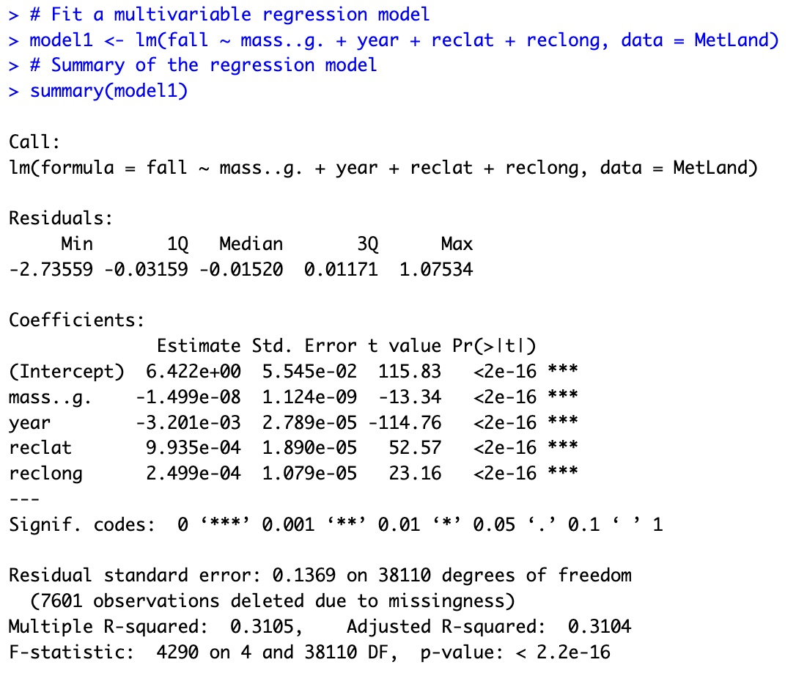
Multivariable Regression Model
Statistical Significance: Three independent variables (year, reclat, and reclong) are statistically significant predictors of fall mass, suggesting their importance in the model.
R-squared Value: The R-squared value of the model is 0.3105, indicating that it explains 31.05% of the variation in fall mass.
Year Coefficient: The negative coefficient for "year" indicates that older meteorite strikes had a lower average fall mass.
Reclat and Reclong Coefficients: Positive coefficients for "reclat" and "reclong" indicate that meteorites landing at higher latitudes and longitudes have heavier average falls.
Relevance of Predictors: Predictors' relevance: The model emphasizes the relevance of "year," "reclat," and "reclong" as important predictors of fall mass.
Moderate R-squared: R-squared value is modest, demonstrating the model's capacity to generate reasonable estimates for fall mass.

Slide 10

Conclusion
It should be highlighted that just one dataset of meteorite landings was used to train the algorithm. On a different dataset, it is likely that the model would not perform as well. In addition, the model does not take into account all of the factors, such as meteorite composition and angle of entry into the Earth's atmosphere, that may affect fall mass.

Slide 11
References
Multivariate logistic regression in R?. Stack Overflow. (1960, August 1). https://stackoverflow.com/questions/23554853/multivariate-logistic-regression-in-r
Chugh, V. (2023, March 17). Logistic regression in R tutorial. DataCamp. https://www.datacamp.com/tutorial/logistic-regression-R

Slide 12

THANK YOU

